Slide 1





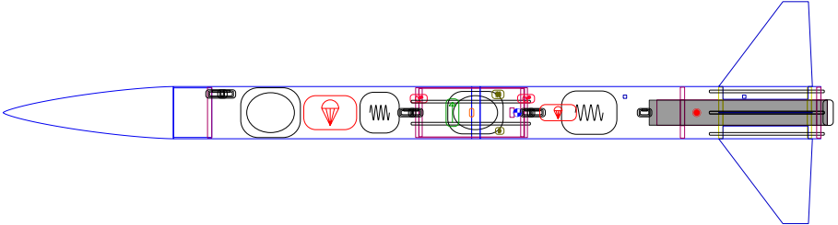
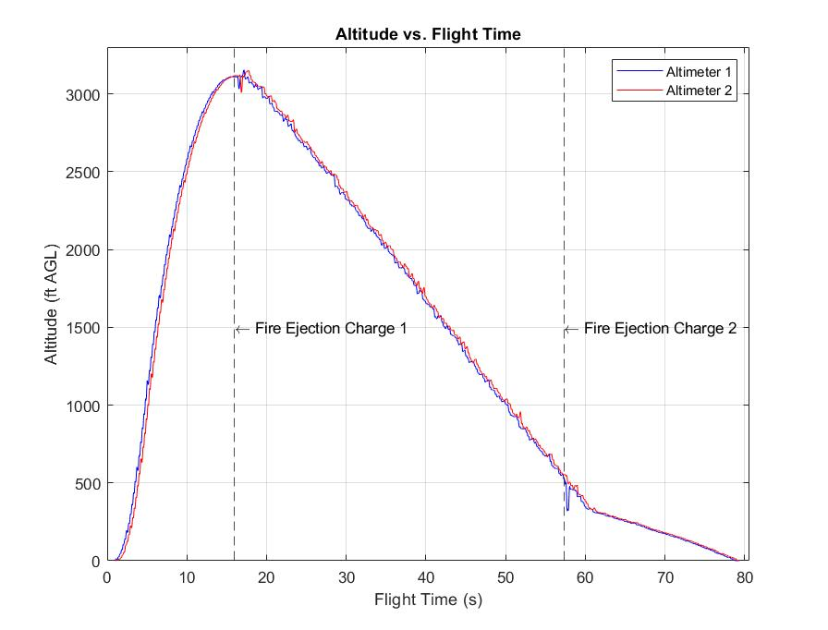
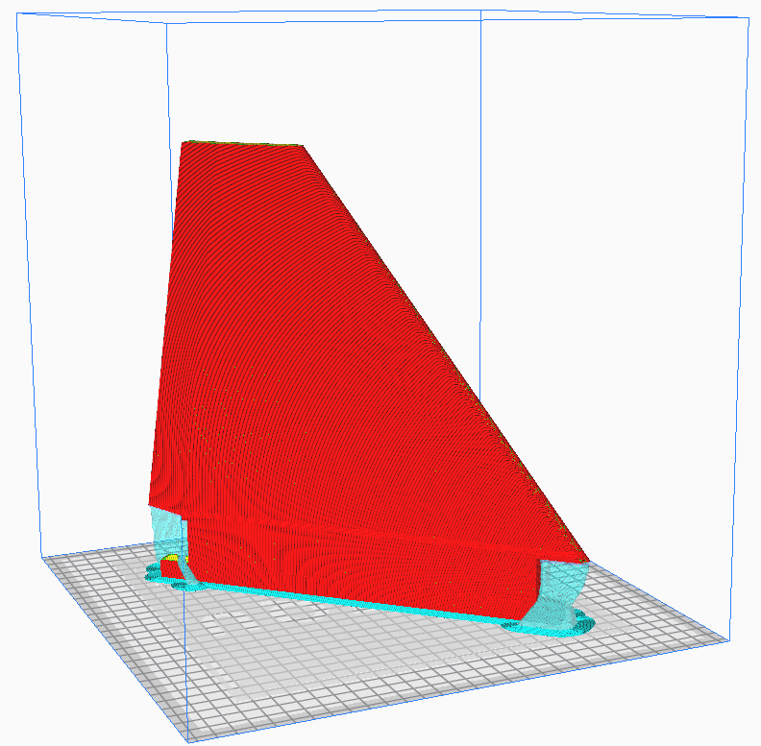
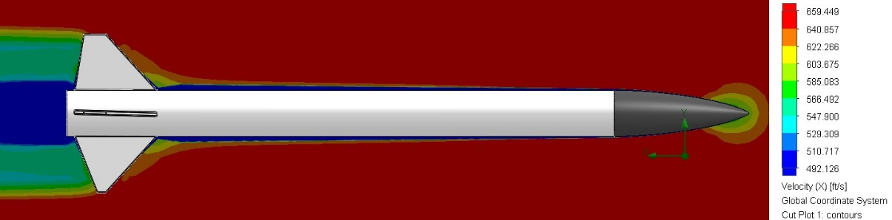
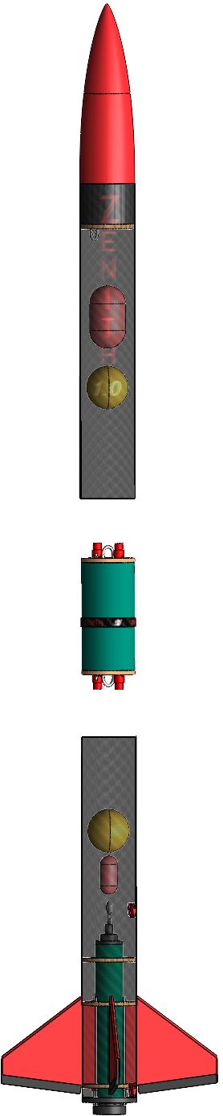
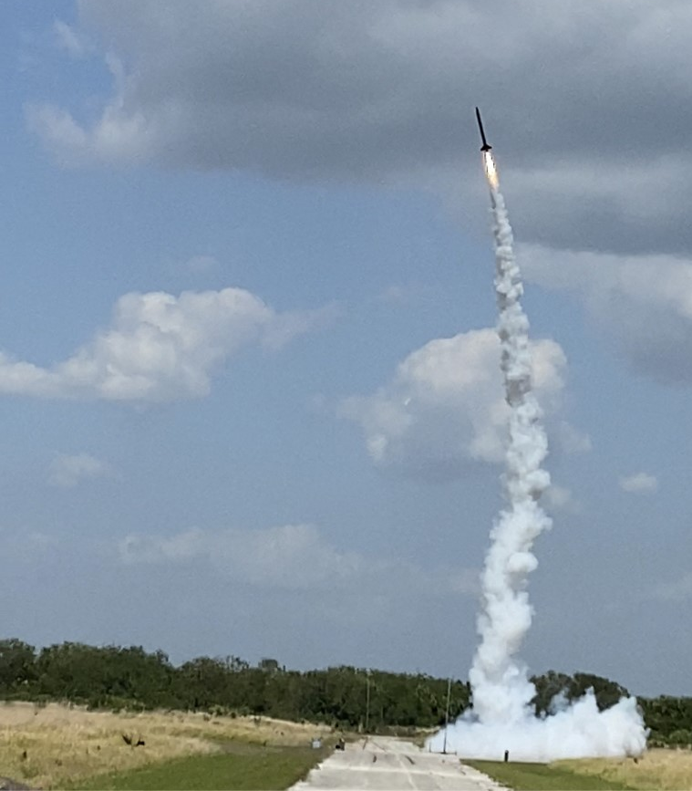
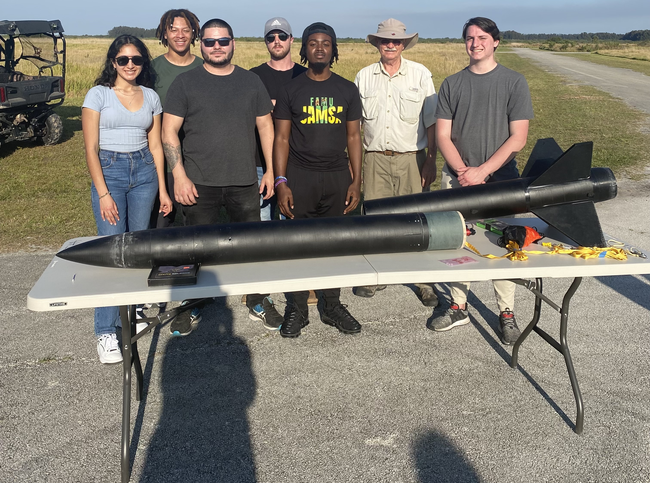
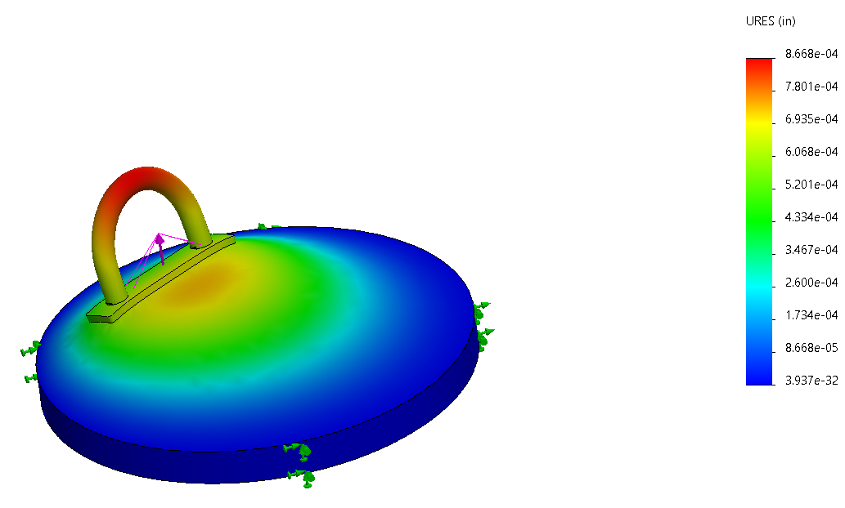
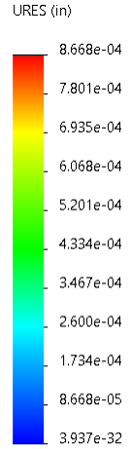




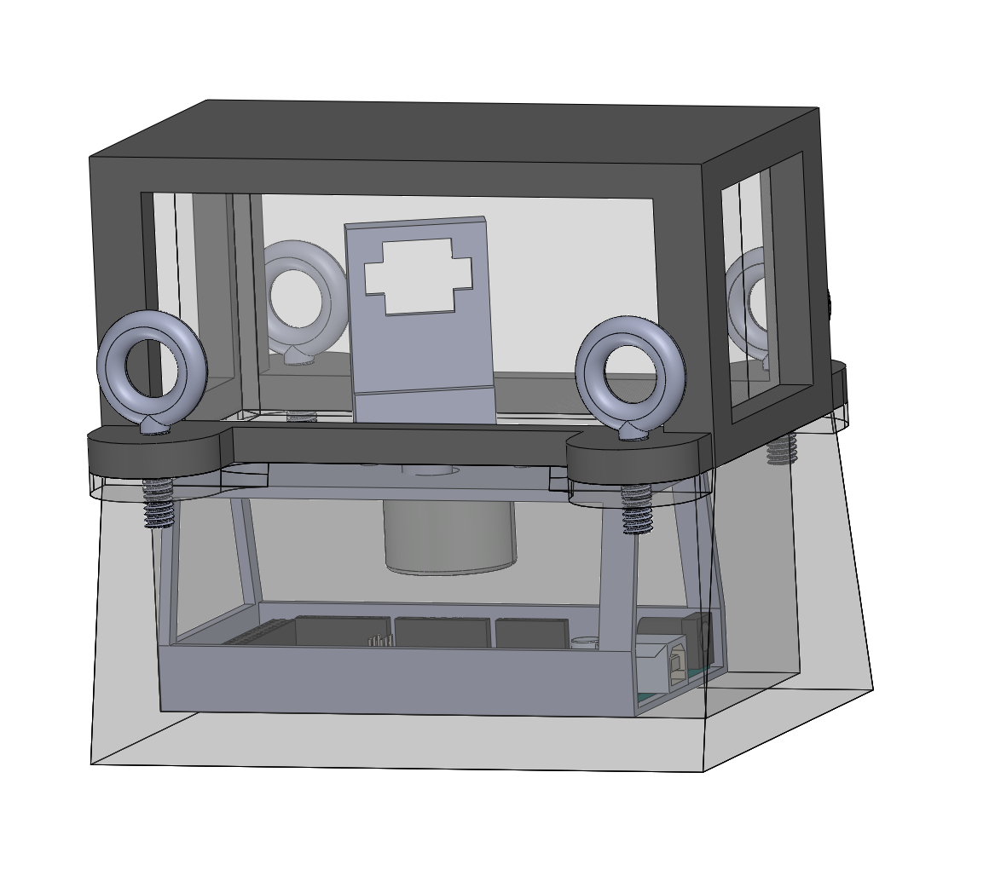




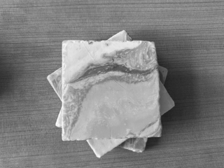
AIAA: NASA Student Launch Competition
Team 501 | Jedreck Acquissa | Peyton Breland | Dylan Gardner | Mark Ioffredo | Zachary Isriel
Sponsors: Shayne McConomy, Ph.D. & William Oates, Ph.D. | Advisor: Chiang Shih, Ph.D.
Objective
Modeling, Simulations, & Flight Tests
Fly a high-powered solid motor rocket to an altitude of 4,600 ft that will deploy a payload. The payload must be capable of receiving and executing a string of radio frequency (RF) commands once it reaches the ground with the launch vehicle. The launch competition will be on April 15, 2023, in Huntsville, AL.
LD – Haack Series Nose Cone
Upper PB
Avionics Bay
Lower PB
Targets
Motor & Fin Can
Payload
Landing Impact Energy
< 75 ft-lb
Wind Drift Distance
< 2500 ft
A combination of OpenRocket, SolidWorks, and PTC Creo were used to design and simulate the flight vehicle. OpenRocket simulations were performed to study the vehicle’s performance under various wind speeds and internal loads. CFD and FEA performed on multiple vehicle components to ensure its integrity and robustness
The payload is a stationary device deployed from the upper payload bay along with the main parachute upon descent. Once the vehicle has landed, the payload will receive a RF sequence of string commands from NASA and decode it to capture images at certain angles then process them to generate different filters.
Thrust-to-Weight Ratio
> 5:1
3D Printed Lexan frame
Stability Margin
2-5 calibers
Lexan window
3D Printed ArduCam Mini housing
¼” eye bolt (4x)
Stepper motor
Altitude
4600 ± 100 ft
Total Descent Time
< 85 s
3D Printed base
Arduino Mega

